Slide 1

Week # 2
Operations Research
(Software Engineering)

Slide 2
Graphical Method of linear programming
A company manufactures two products A and B. Both products are processed on two machines M1 and M2.
Profit per unit of A is Rs=100 and for B is Rs=80. Find out the monthly production of A and B to maximize profit.
Products | M1 | M2
A | 6 hrs/Unit | 2 hrs/Unit
B | 4 hrs/Unit | 4 hrs/Unit
Availability | 7200 hrs/Unit | 4000 hrs/Unit

Slide 3
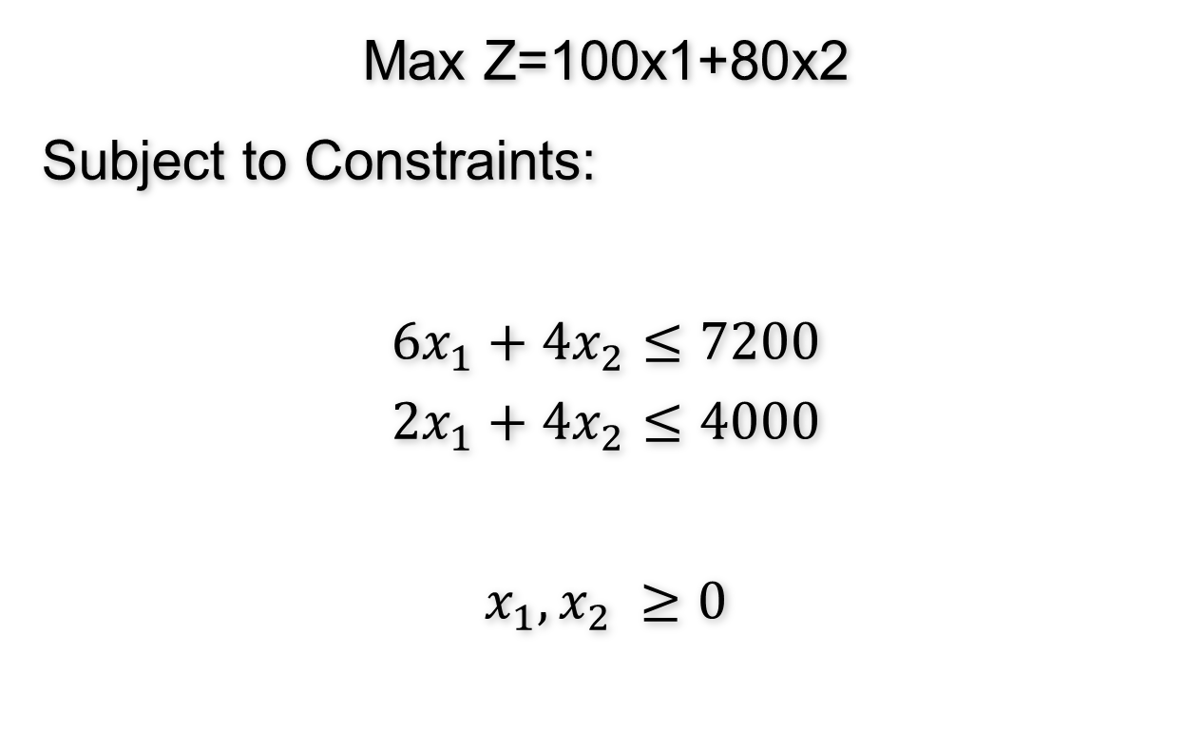
Graphical Method of linear programming
Max Z=100x1+80x2
Subject to Constraints:
$$6x_{1}+4x_{2}≤7200$$
$$2x_{1}+4x_{2}≤4000$$
$$x_{1},x_{2} ≥0$$

Slide 4
Graphical method of linear programming
Constraint No. 1: 6 X1 + 4 X2 ≤ 7200
Converting into equality:
6X1 + 4X2 = 7200
X1 is the intercept on X axis and X2 is the intercept on Y axis.
To find X1, let X2 = 0
6X1 = 7200

Slide 5
Graphical method of linear programming
X1= 1200; X2 = 0 (1200, 0)
To find X2, let X1 = 0
4X2 = 7200
X2 = 1800; X1 = 0 (0, 1800)
Hence the two points which make the constraint line are:
(1200, 0) and (0, 1800)

Slide 6
Graphical method of linear programming
Constraint No. 2: 2X1 + 4X2 ≤ 4000
To find X1, let X2 = 0
2X1 = 4000
X1= 2000; X2 = 0 (2000, 0)
To find X2, let X1 = 0
4X2 =4000
X2= 1000; X1 = 0 (0, 1000)

Slide 7
Graphical method of linear programming
Each constraint will be represented by a single straight line on the graph. There are two constraints, hence there will be two straight lines.
The co-ordinates of points are:
1. Constraint No. 1: (1200, 0) and (0, 1800)
2. Constraint No. 2: (2000, 0) and (0, 1000)

Slide 8
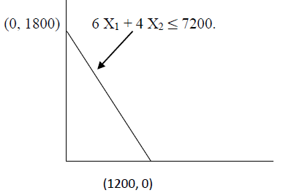
Graphical method of linear programming
Constraint No. 1:
The line joining the two points (1200, 0) and (0, 1800) represents the constraint
6 X1 + 4 X2 ≤ 7200.

Slide 9
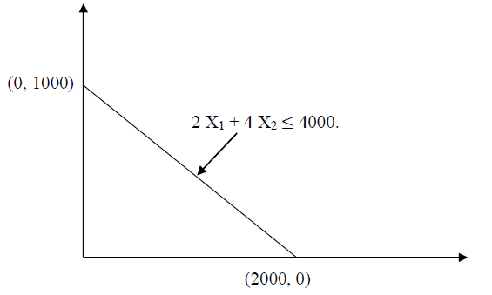
Graphical method of linear programming
Constraint No. 2:
The line joining the two points (2000, 0) and (0, 1000) represents the constraint
2 X1 + 4 X2 ≤ 4000

Slide 10
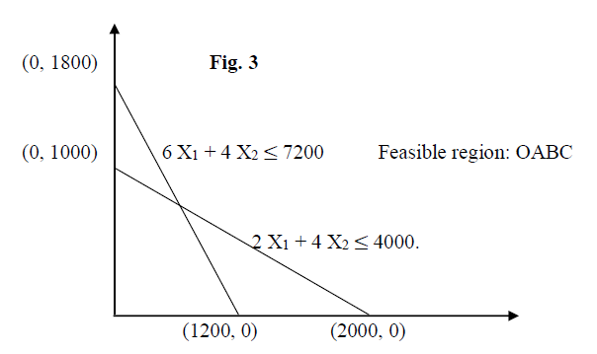
Graphical method of linear programming

Slide 11
Graphical method of linear programming
Both the constraints are 'less than or equal to' (≤) type. Hence, the feasible region should be inside both constraint lines.
Hence, the feasible region is the OABC. 'O' is the origin whose coordinates are (0, 0). O, A, B and C are called vertices of the feasible region.

Slide 12
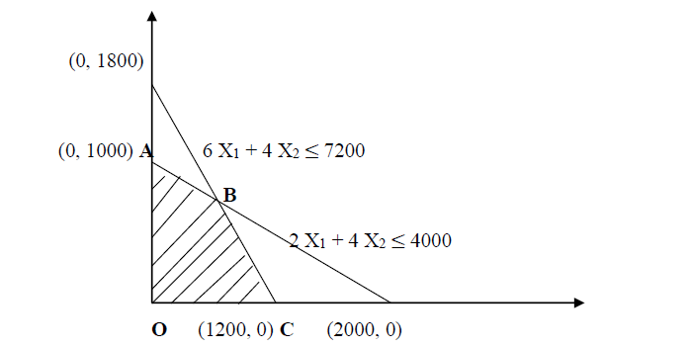
Graphical method of linear programming

Slide 13
Graphical method of linear programming
We have two equations and two unknowns, X1 and X2. Solving simultaneously.
6 X1 + 4 X2 ≤ 7200 (1)
2 X1 + 4 X2 ≤ 4000 (2)
4 X1 = 3200 Subtracting (2) from (1)
X1 = 800
Substituting value of X1 in equation (1), we get
4 X2 = 2400
X2= 600

Slide 14
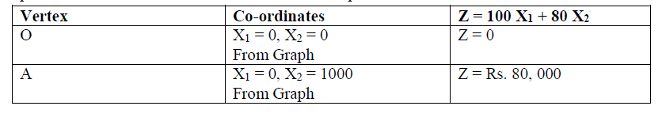
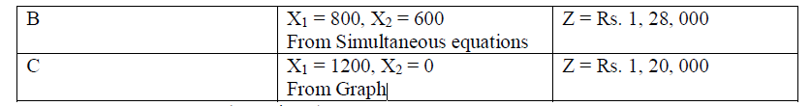
Graphical method of linear programming
Finding the optimal Solution
The optimal solution always lies at one of the vertices or corners of the feasible region.

Slide 15
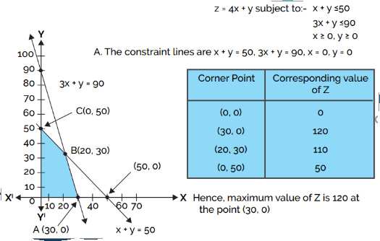
Graphical method of linear programming

Slide 16
Task1
A and B are two products to be manufactured. Maximum availability of material is 60kg and 96 Man-Hours respectively. Each unit of A needs 2 Kg of material and 3 Man-Hours, Whereas each unit of B need 4 Kg of material and 3 Man-Hours. Unit profits of A is 40 dollars and for B is 35 dollars respectively. Find the Optimal Solution by using Graphical Method.

Slide 17
Task1
Products | Material | Man-Hours | Profit
A | 2 Kg | 3 | 40
B | 4 Kg | 3 | 35
Availability | 60Kg | 96
X1 =No of Product A to be manufactured

Slide 18
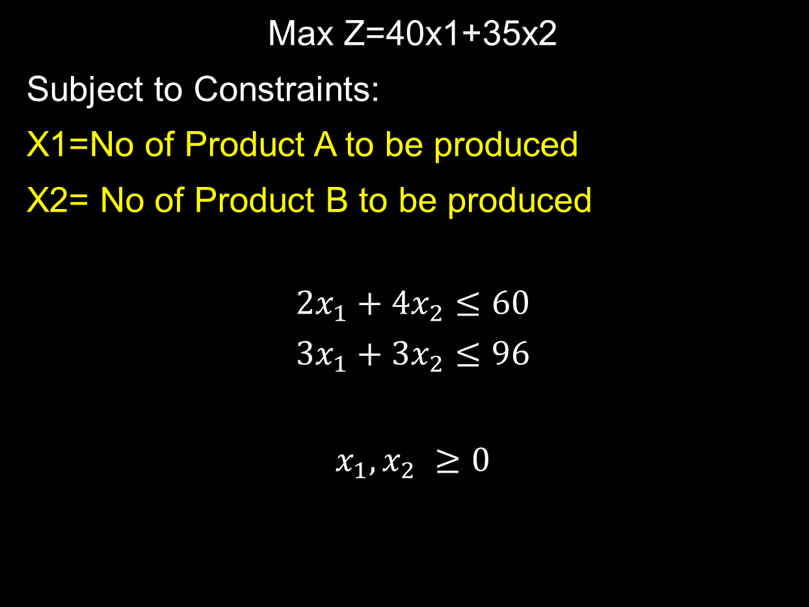
Task 1
Max Z=40x1+35x2
Subject to Constraints:
X1=No of Product A to be produced
X2= No of Product B to be produced
$$2x_{1}+4x_{2}≤60$$
$$3x_{1}+3x_{2}≤96$$
$$x_{1},x_{2} ≥0$$

Slide 19

Task 2
Max Z=3x1+5x2
Subject to Constraints:
$${ x}_{1}+2x_{2}≤2000$$
$$x_{1}+x_{2}≤1500$$
$$x_{2}≤600$$
$$x_{1},x_{2} ≥0$$

Slide 20
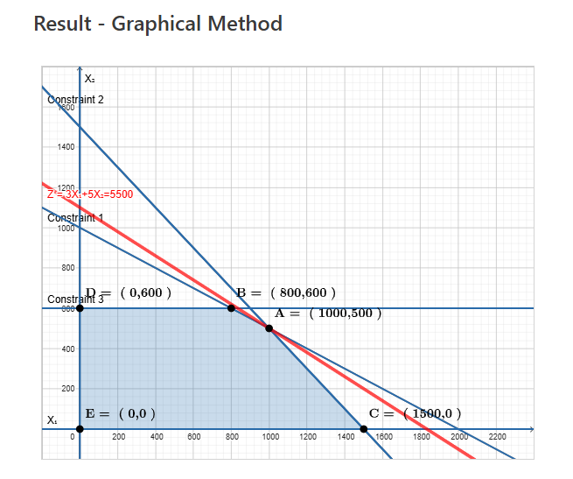

Slide 21
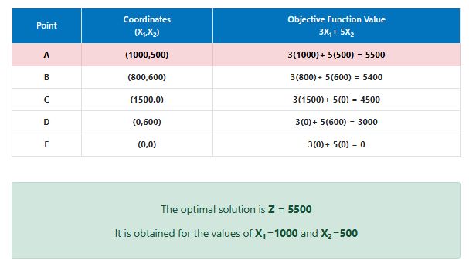

Slide 22
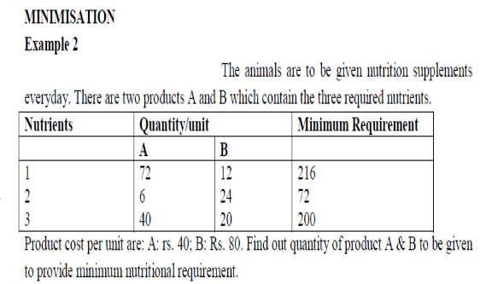
Example

Slide 23
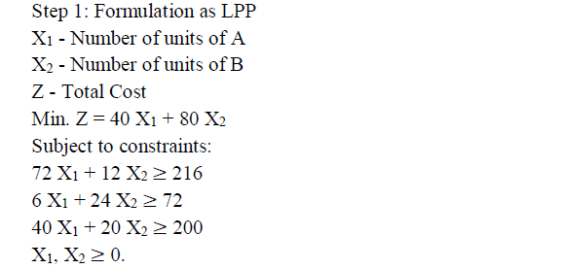
Example

Slide 24
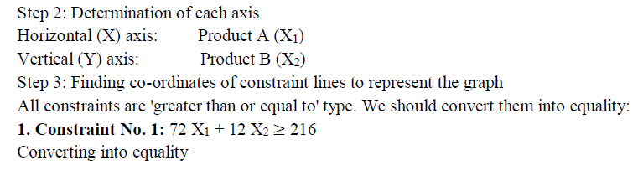
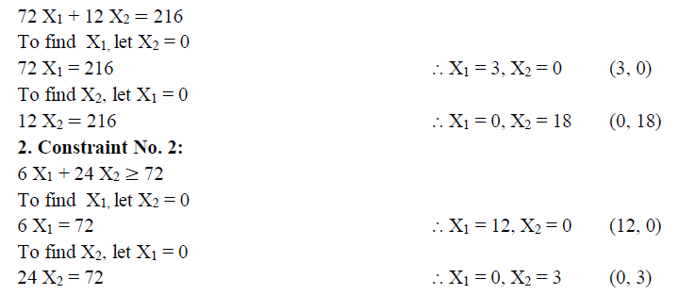
Example

Slide 25
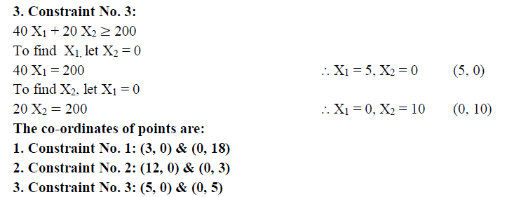
Example

Slide 26
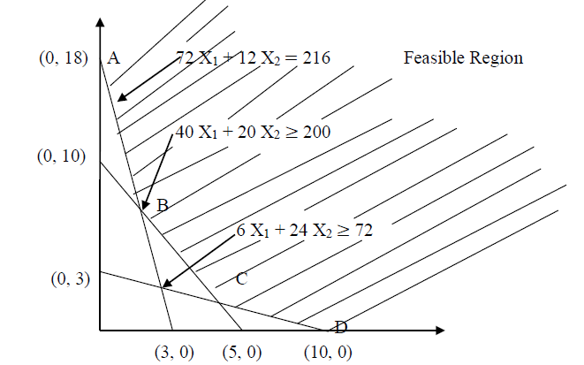
Example

Slide 27
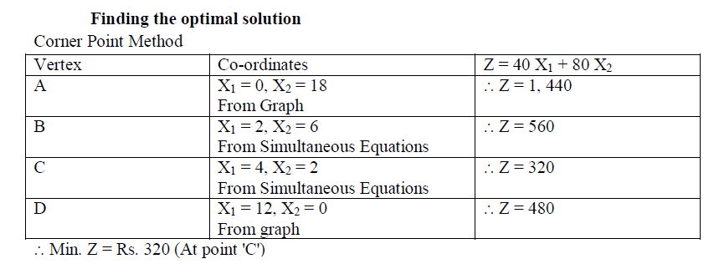
Example

Slide 28
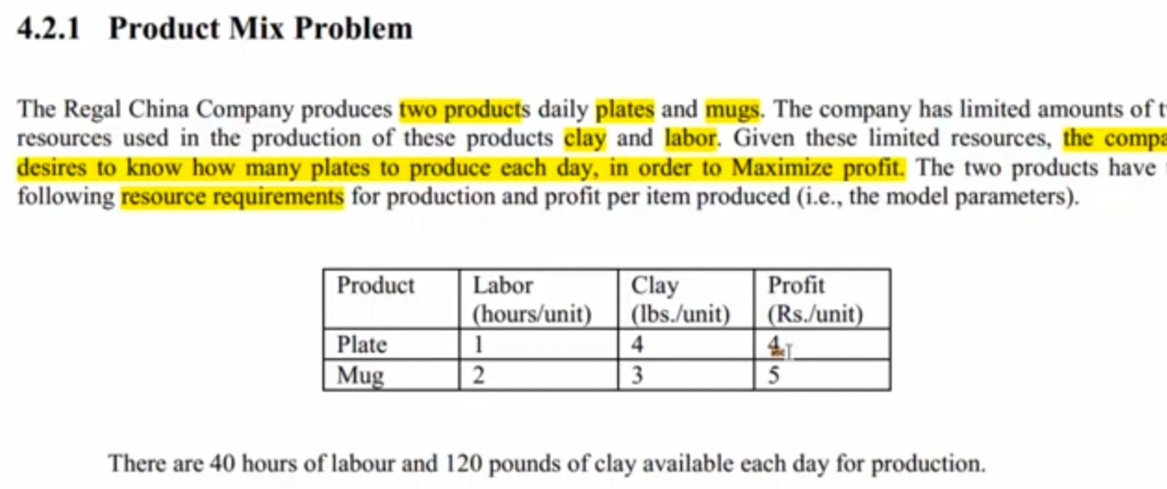

Slide 29
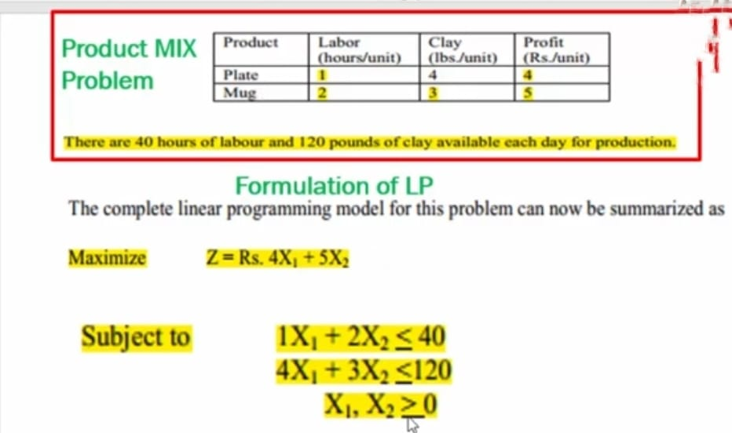

Slide 30
Thank you!

